Slide 1
Interval Heap
-Ambuj Mishra
(2021PCS1017)

Slide 2
Basic Node Structure
Parent ptr (default = NULL)
Vector
Left ptr (default = NULL)
Right ptr (default = NULL)

Slide 3
Maintaining End-ptr
I used dequeue to maintain the end-pointers.
Front of dequeue will always contain the end-ptr. So, inserting new element on the end-ptr can be performed directly in O(1).
As soon as the size of any node’s vector reaches 2, we pop it from the front of dequeue and push_back() it’s left node and right node.
Front
Back

Slide 4
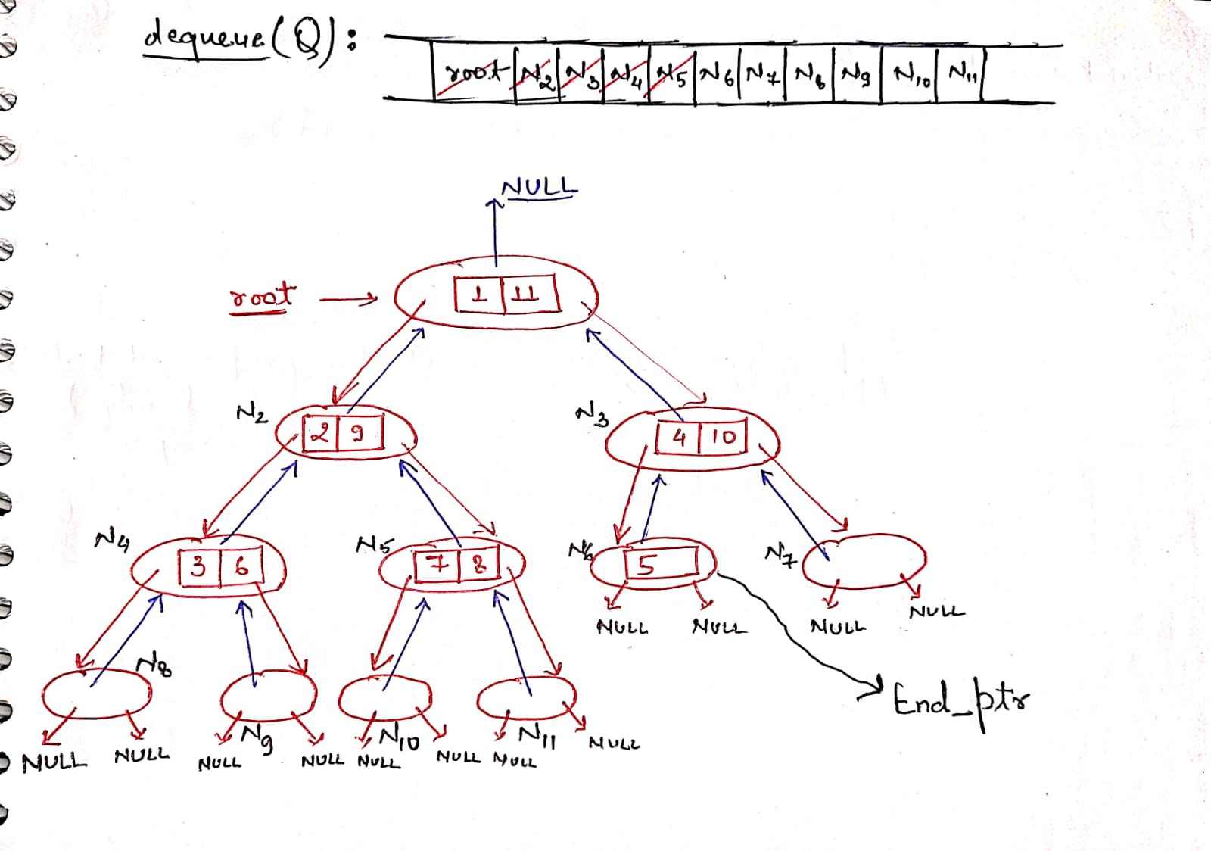
Inserting 11 values from 1 to 11

Slide 5
Insertion Algorithm
Fetch the end-ptr from dequeue. Insert the new value in end-ptr’s vector and check for swapping inside node.
If the size() of end-ptr’s vector is 2, then pop it from front and push_back() it’s left and right node otherwise let it be.
Keep on comparing and swapping the value with their parent’s values until we reach the optimal position.
Repeat the process.

Slide 6
Deletion Algorithm
First put the required value from the root in a temporary variable to return it at last.
Then fetch the end-ptr, copy the value to be deleted from it to popped root and delete that value from the end-ptr.
Make suitable changes in dequeue.
Now, keep on comparing and swapping the values from root to it’s children until we reach the optimal position.
Check swapping inside nodes as well.

Slide 7
Deletion Methodology (Regarding changes in dequeue)
If the end-ptr or front of dequeue has only 1 element then remove that element and put it in the root where the value is popped out and then follow deletion algorithm. Keep the dequeue same.
If the end-ptr has 0 elements then first of all push_front() the parent of last element of dequeue because it’ll be the last pointer holding values and then pop_back() 2 times from the dequeue.
There will be no case where front has 2 or more elements.

Slide 8
Analysis
Time complexity for single insertion and deletion : O(log n)
because we are moving through the height of heap only.
Time complexity to build or delete the complete heap with n elements : O(n.log n)
Space complexity in worst case : size of last level

Slide 9
Alternative Approach
If the size of the heap is really big and we can’t afford to handle such large space complexity, then we have to increase time complexity to minimize space complexity. We can find end-ptr by keeping an extra single pointer at last node and keep on updating it every time insertion is performed. Space complexity may reduce drastically but TC will increase.
We can therefore find a tradeoff but that will require a lot of data.

Slide 10
Final Result

Slide 11
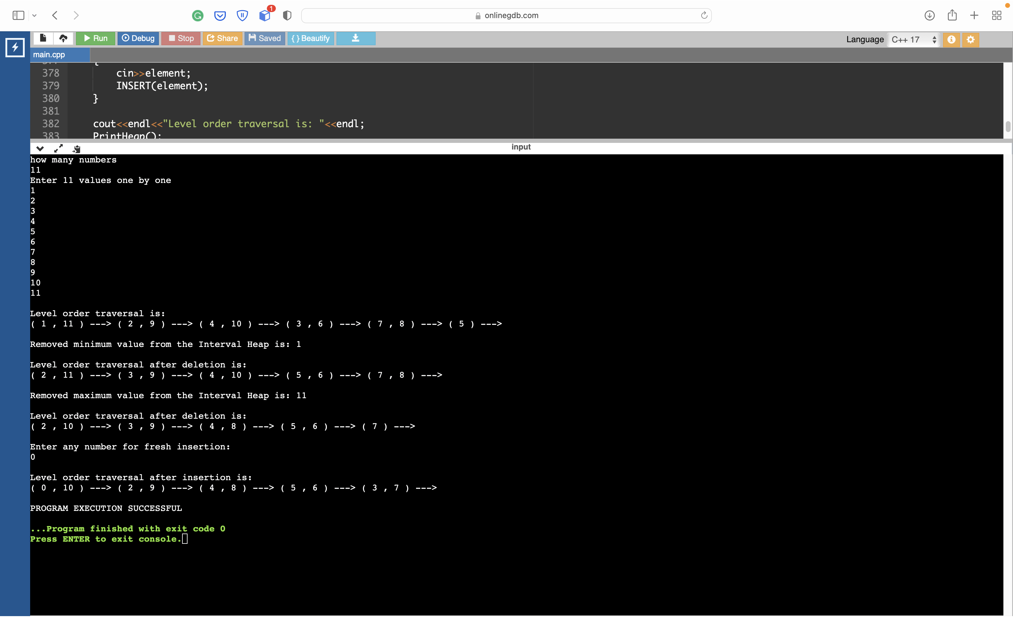

Slide 12
THANK YOU!

